Slide 1
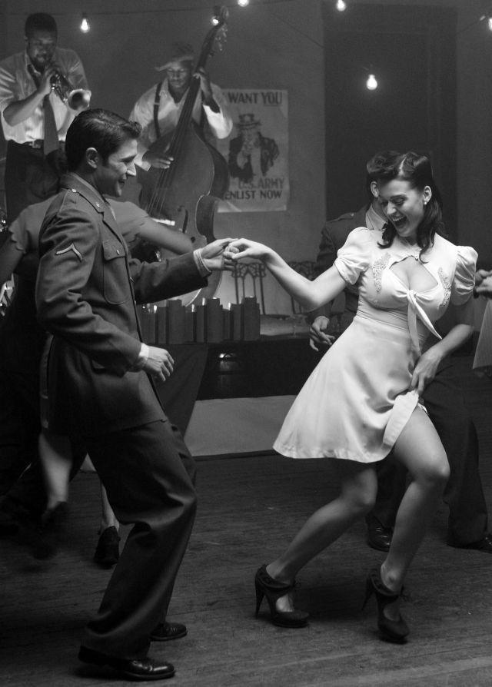
What is Jive?
JIVE
1
History of Jive
2
Characteristics of Jive
3
Video Presentation of Jive
4
Movement Skills of Jive
5
Fitness Benefits of Jive
6
Dietary Goals of Jive
7

Slide 2

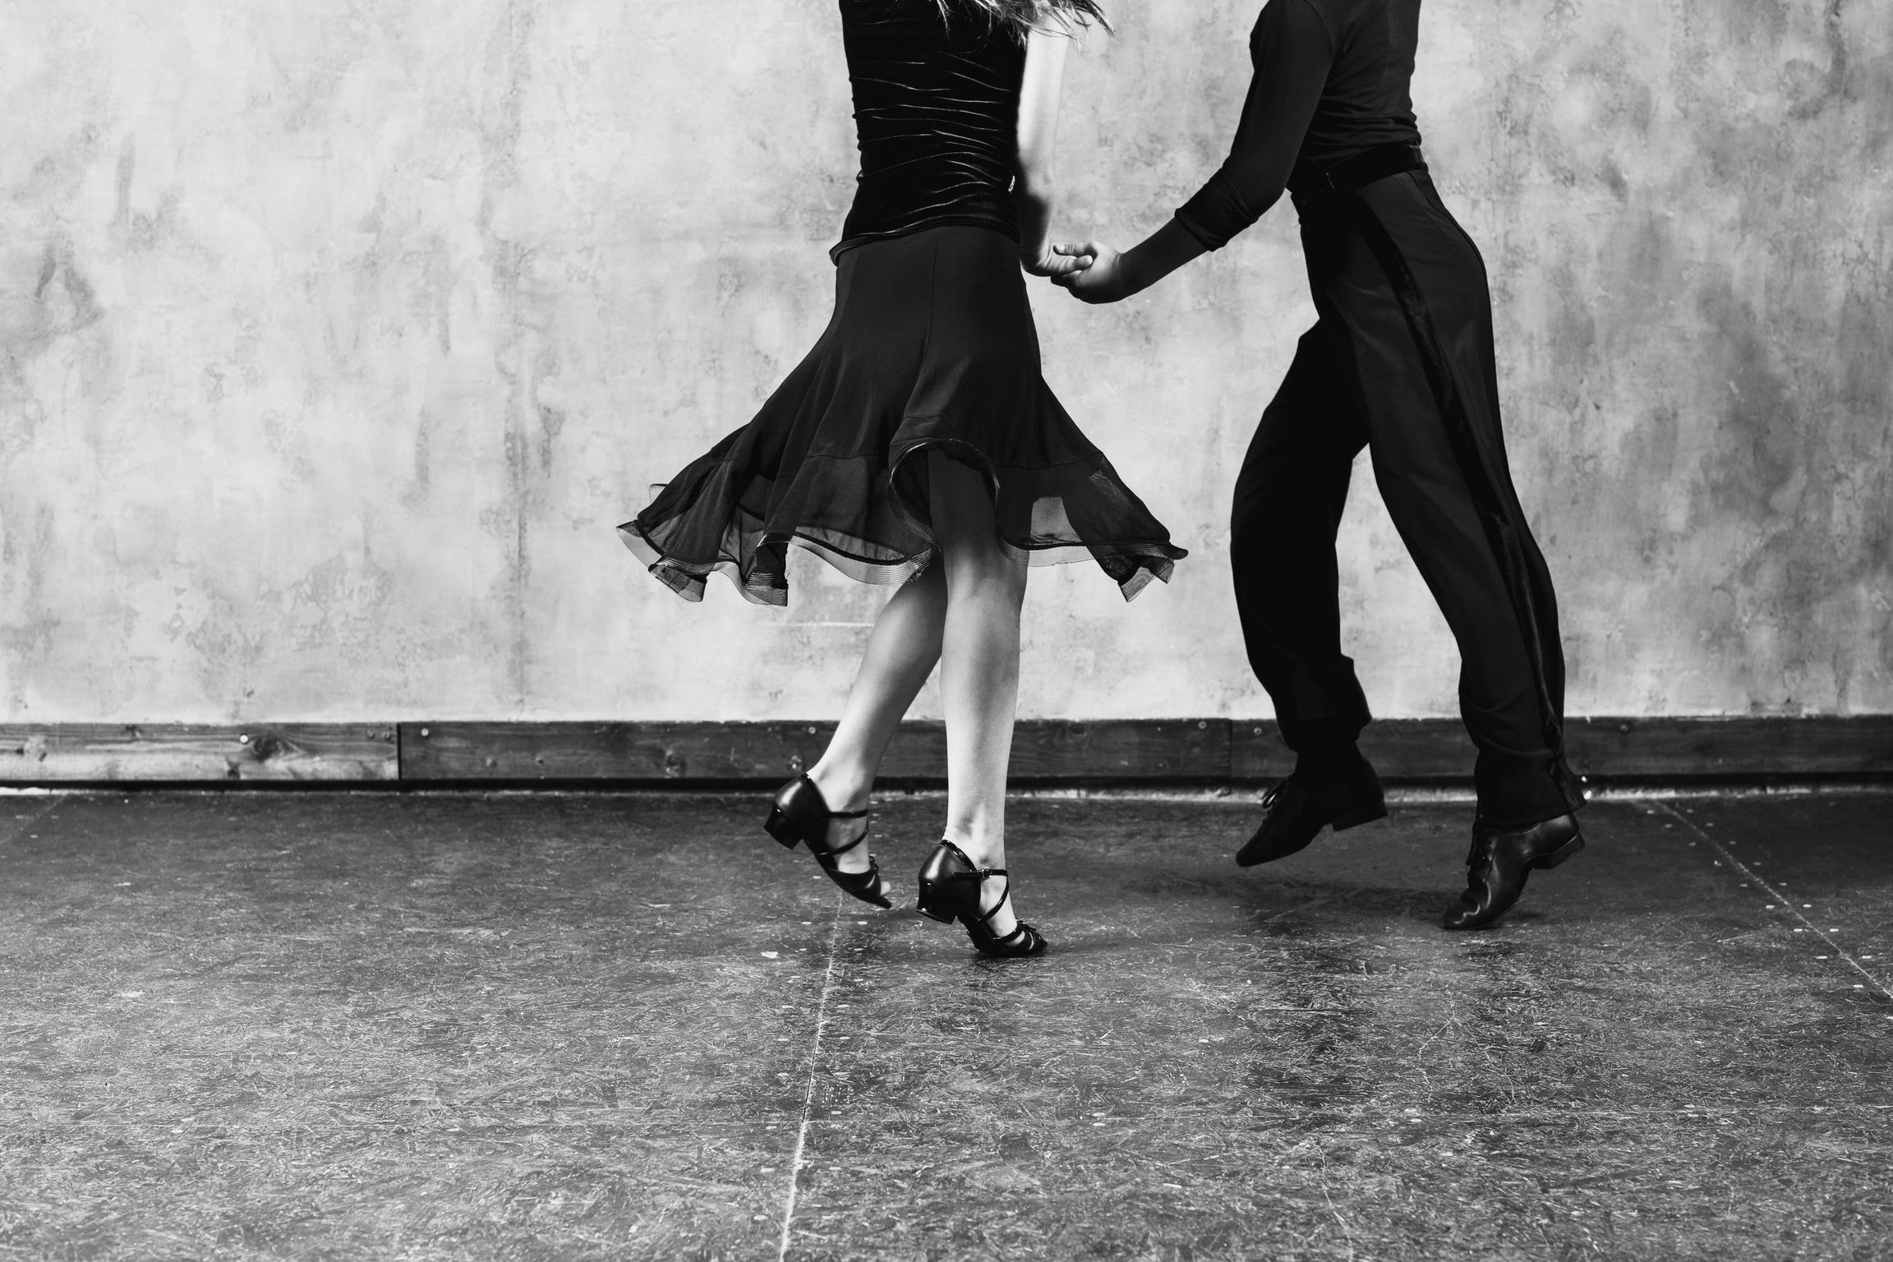


JIVE INTRODUCTION
JIVE
Jive is a type of swing dance that originated in African-American communities in the United States in the 1930s. It is characterized by its fast tempo, acrobatic moves, and improvisational nature. Jive is often danced to swing music, but it can also be danced to other types of music, such as jazz, blues, and funk.

Slide 3
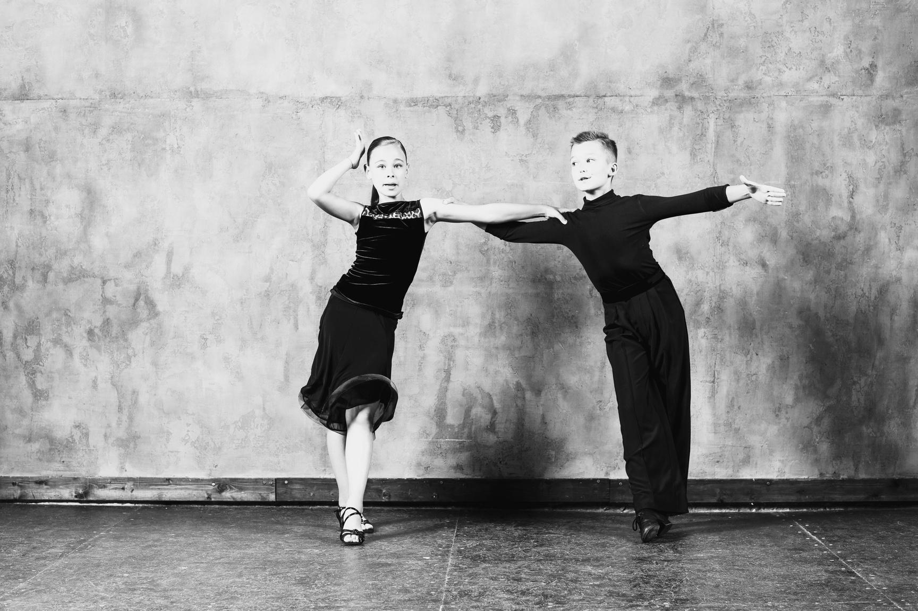

JIVE HISTORY
HISTORY OF JIVE
The word "jive" is believed to have originated in the African-American community in the early 20th century. It is thought to be a corruption of the word "jitterbug", which was a popular dance in the 1920s.
In the 1940s, jive became a popular dance on the big screen. Movies like "Stormy Weather" and "The Cotton Club" featured jive dancers, and this helped to popularize the dance among a wider audience. Jive also became popular in the United Kingdom in the 1940s, and it was featured in the movie "The King and I".

Slide 4
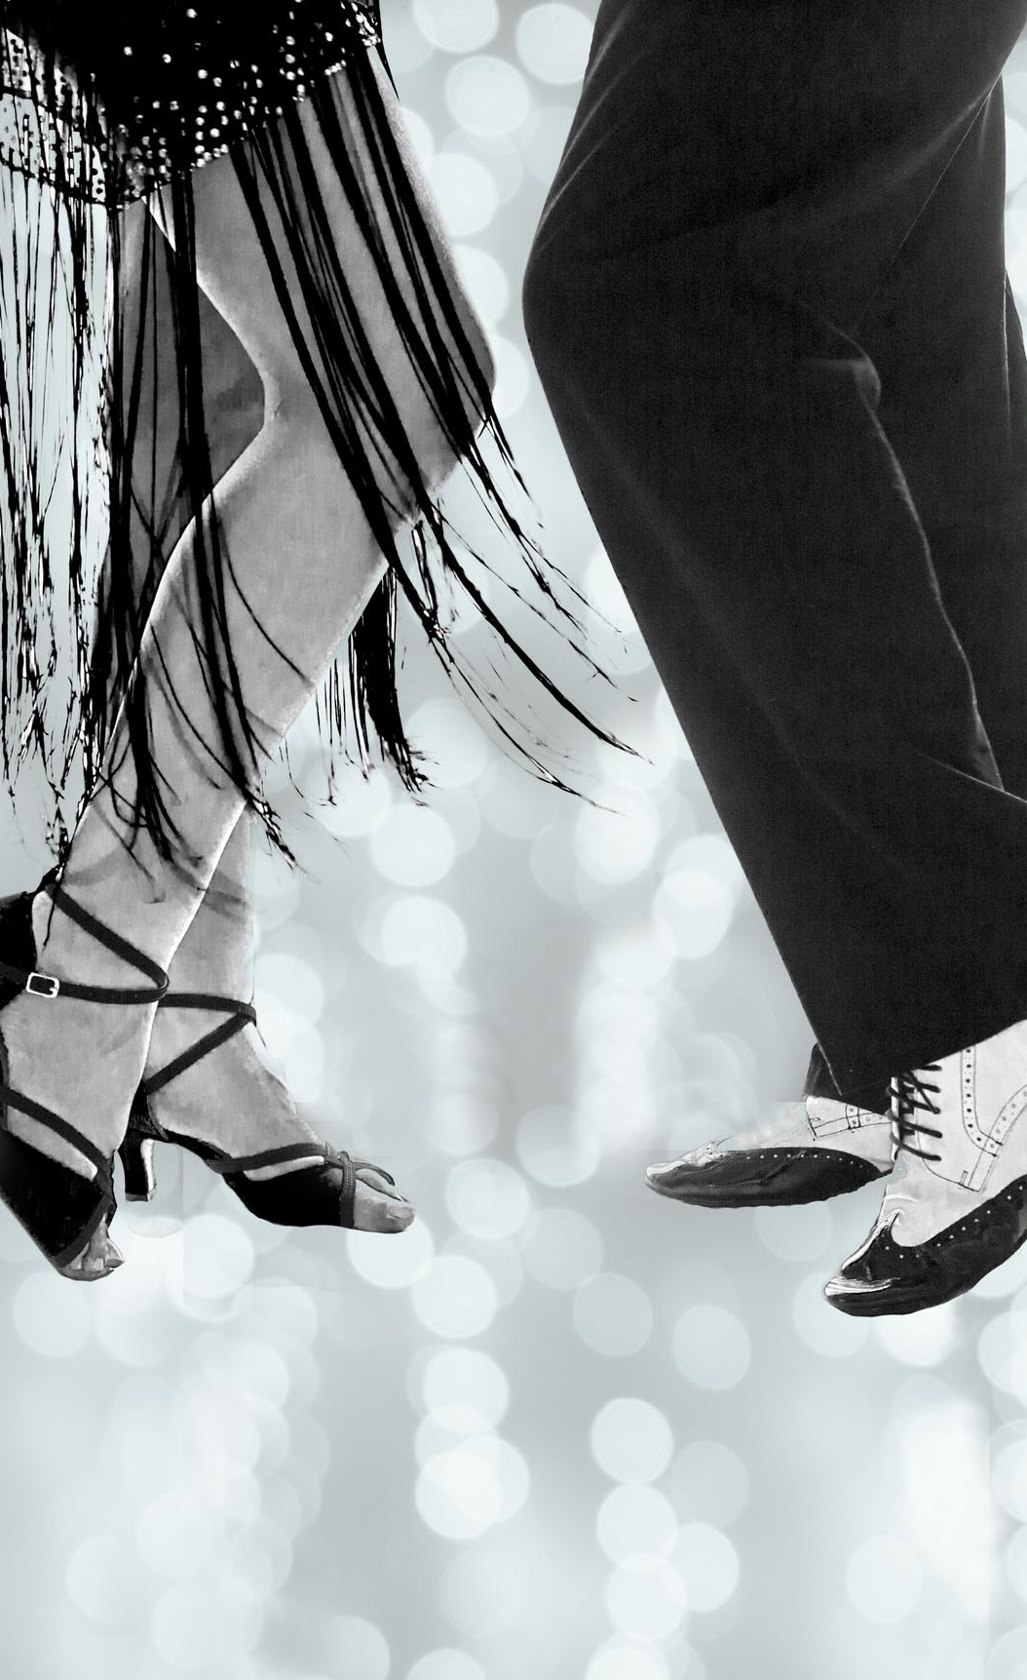
HISTORY OF JIVE
Jive continued to be popular in the 1950s and 1960s, and it was featured in many popular songs of the era, such as "Rock Around the Clock" and "Shake, Rattle and Roll". Jive also became popular in the ballroom dance scene, and it is still a popular dance today.

Slide 5
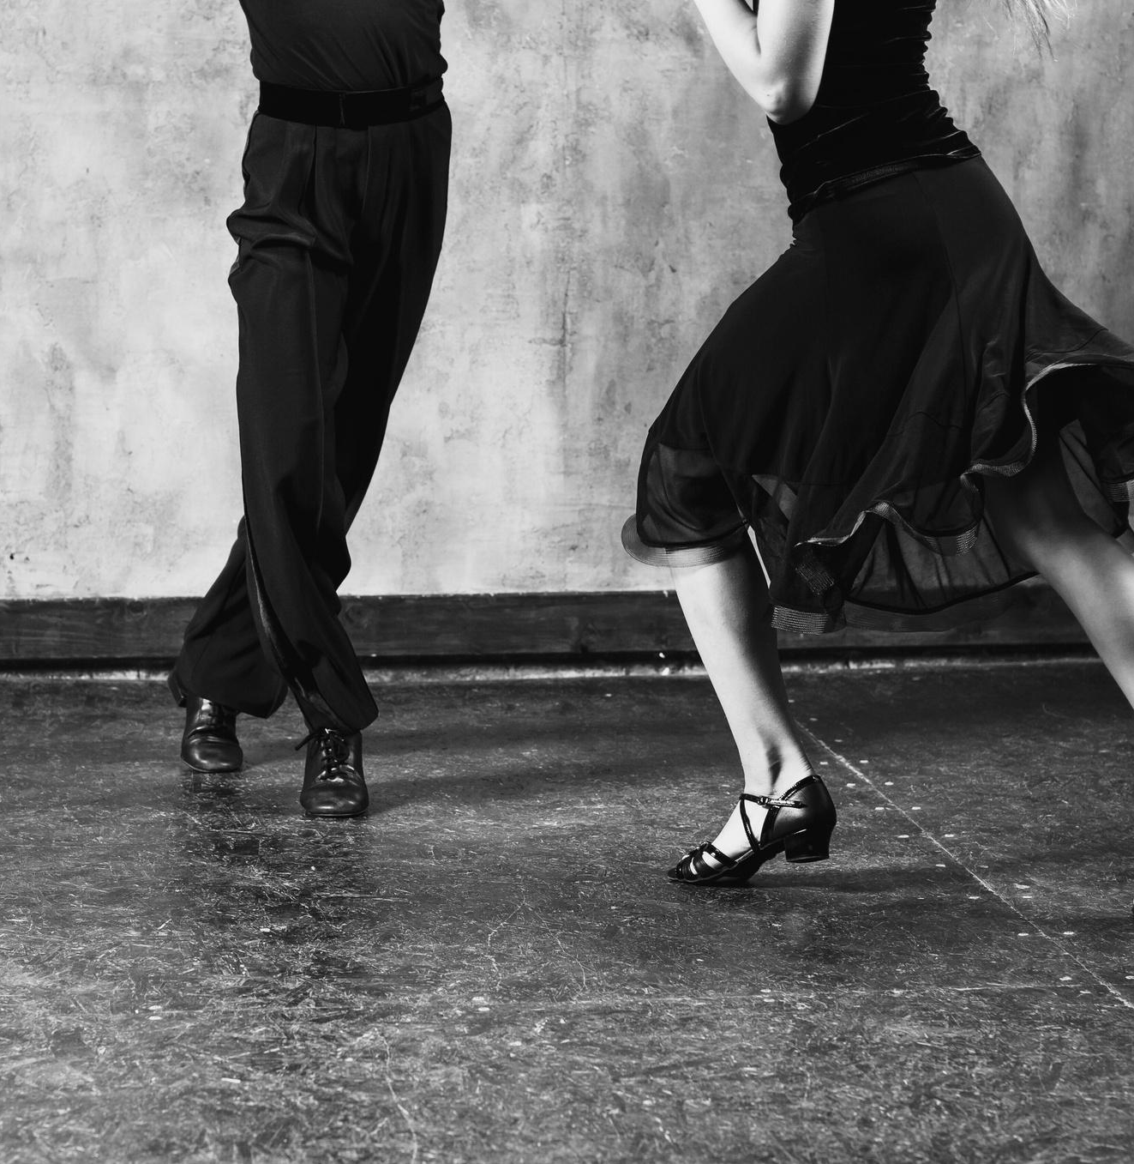
JIVE DANCERS
CAB CALLOWAY
Calloway was an African-American singer and dancer who was one of the first people to popularize jive in the United States. He is known for his energetic performances and his signature dance moves, such as the "jitterbug" and the "Charleston".

Slide 6
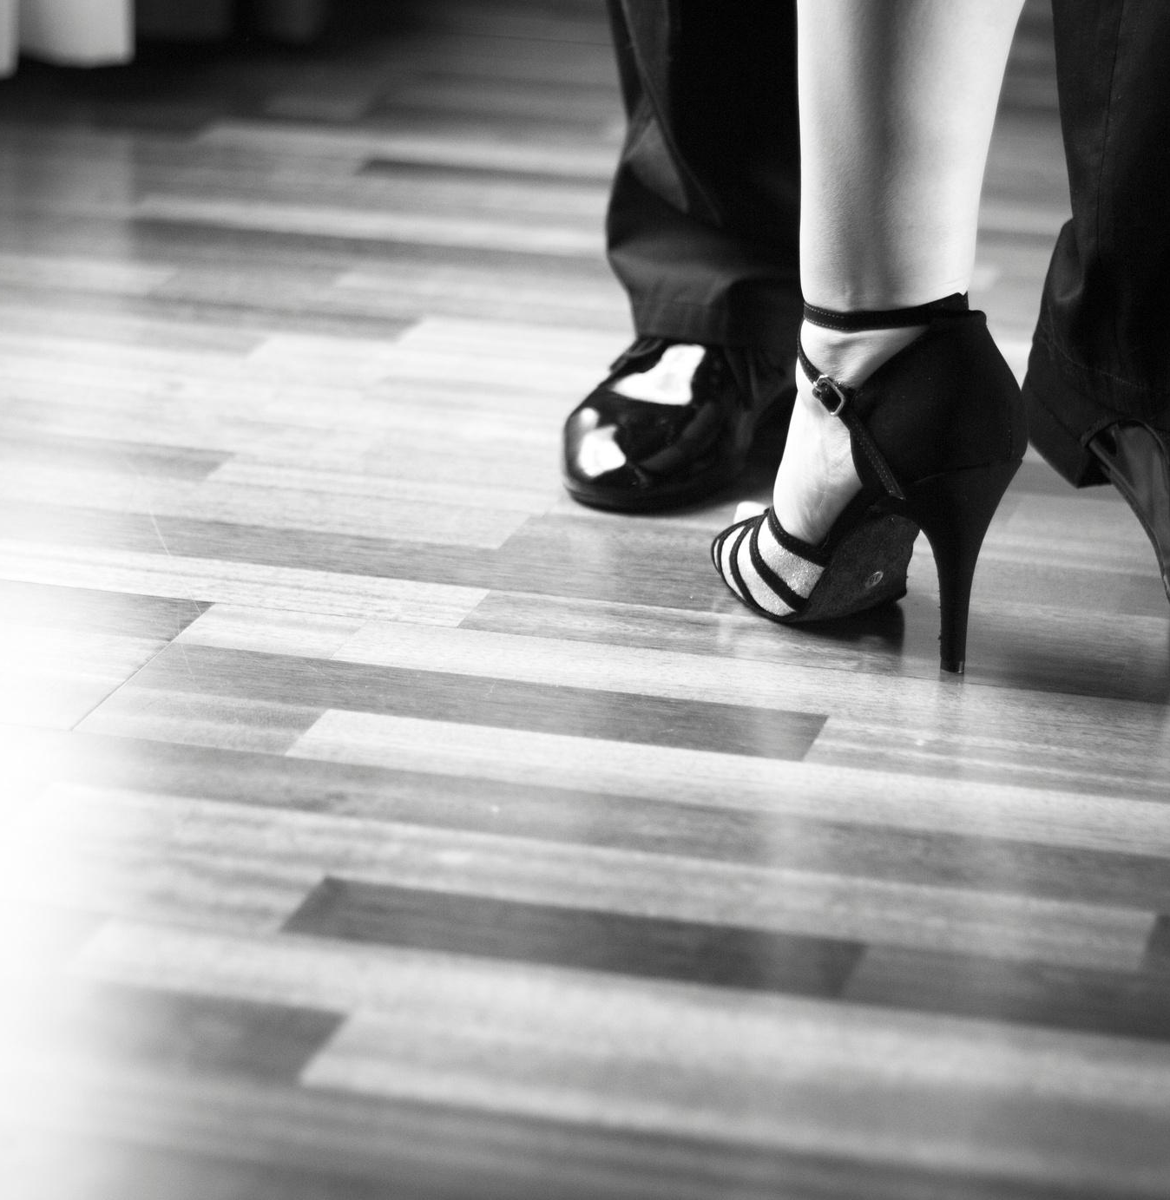
JIVE DANCERS
BILL
BAILEY
Bailey was an African-American dancer who was known for his acrobatic jive moves. He was one of the first people to perform jive on the big screen, and he appeared in movies like "Stormy Weather" and "The Cotton Club".

Slide 7
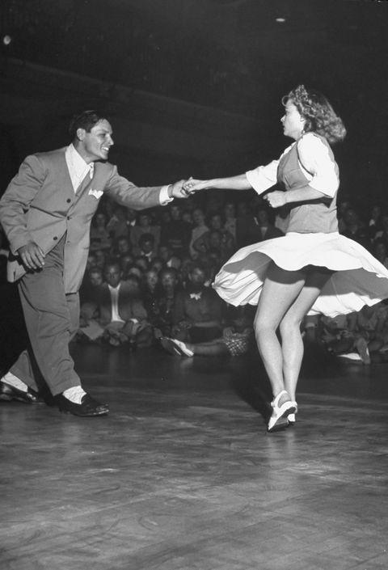
JIVE
CHARACTERISTICS JIVE
The word "jive" is still frequently used to refer to all swing dancing variations. The Jive is one of five International Latin dances that are used in competitive ballroom dancing. The East Coast Swing shares many of its fundamental patterns with the Jive, however the Jive is typically performed to a quicker, highly syncopated beat. The Jive features high knee lifts, bouncy steps, and hip swings.

Slide 8
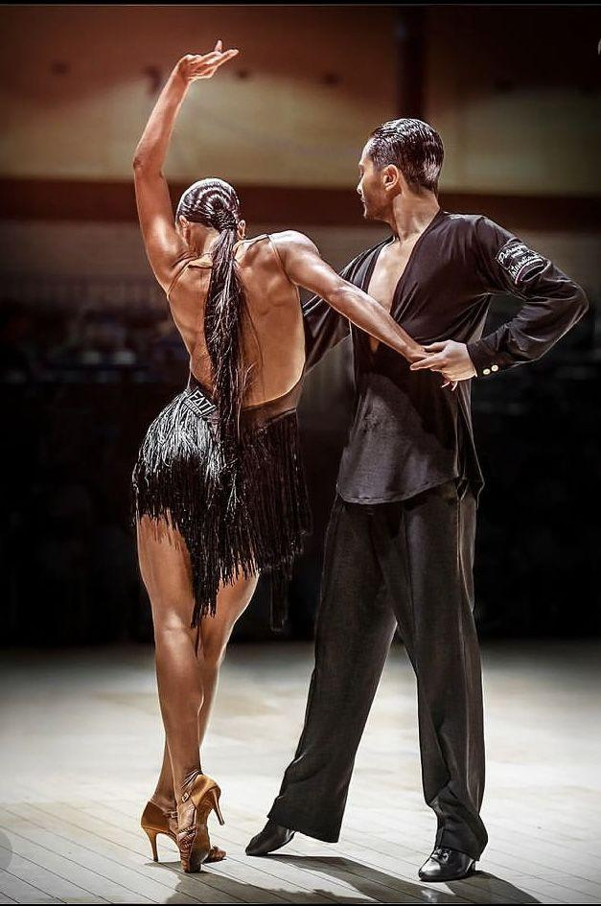
JIVE
CHARACTERISTICS JIVE
Jive has a basic appearance and feel that is characterized by intense energy and pumping motions in the legs. Two triple steps and a rock step make up the East Coast swing and the fundamental jive, respectively. The jive varies from other dances in that the count starts with the rock step, which is counted "1, 2," and continues with the two triple steps, which are counted "3 and 4" and "5 and 6," respectively.

Slide 9
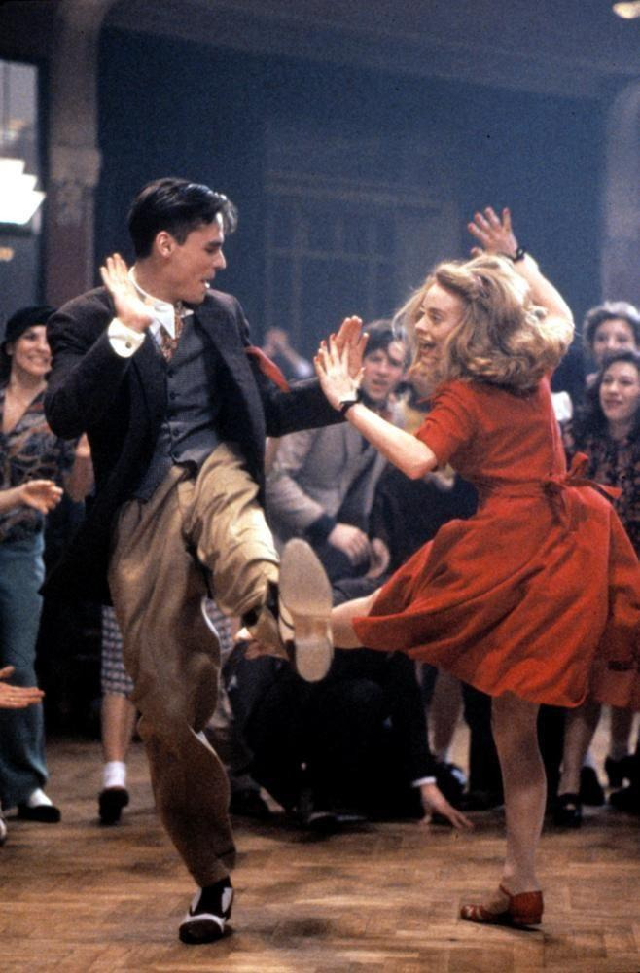
JIVE
CHARACTERISTICS JIVE
Jive is an extremely upbeat, bouncy, energetic dance that involves lots of knee-lifting, bending, and hip-rocking. Jive, the quickest of the Latin dances, doesn't move across the dance floor like other dances and instead features numerous kicks, flicks, and even female twirling. Despite the fact that jive dancers' feet may appear to be moving erratically in all directions, the feet are actually tightly controlled below the torso with the knees close together.

Slide 10
HOW TO DO BASIC JIVE STEPS
LET'S JIVE IN!

Slide 11

https://youtu.be/MA4iYUyWyXw
Basic Jive Steps

Slide 12
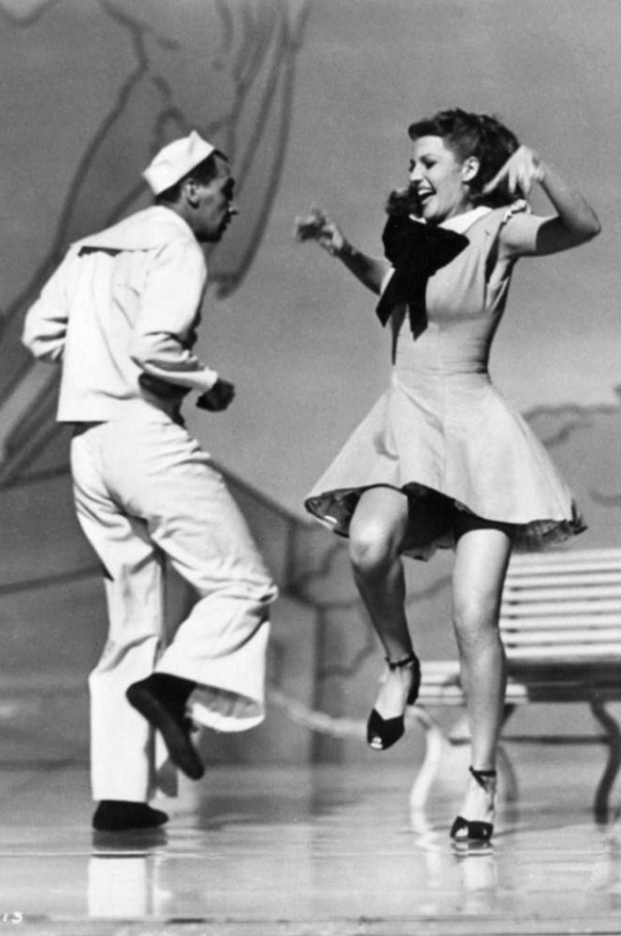
MOVEMENT SKILLS
OF JIVE
Basic Men's Steps
Step back with your left foot (Rock step)
Right foot in place, weight shifts to it
Sidestep to the left with your left foot (Chasse to the left)
Move your right foot to your left foot
Sidestep to the left with your left foot
Right foot in place, weight shifts to it (Chasse to the right)
Sidestep to the right with your left foot
Sidestep to the right with your right foot
Learn More

Slide 13
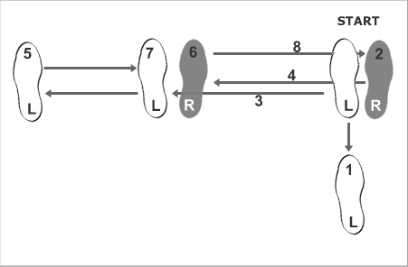
MOVEMENT SKILLS
OF JIVE
Basic Men's Steps
Learn More

Slide 14
MOVEMENT SKILLS
OF JIVE
Basic Lady's Steps
Step back with your right foot (Rock step)
Left foot in place, weight shifts to it
Sidestep to the right with your right foot (Chasse to the right)
Move your left foot to your right foot
Sidestep to the right with your right foot
Left foot in place, weight shifts to it (Chasse to the left)
Sidestep to the left with your right foot
Sidestep to the left with your left foot
Learn More

Slide 15
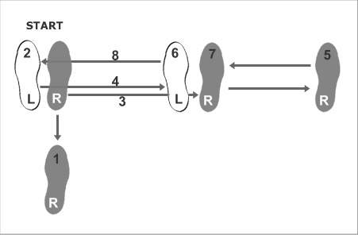
MOVEMENT SKILLS
OF JIVE
Basic Lady's Steps
Learn More

Slide 16
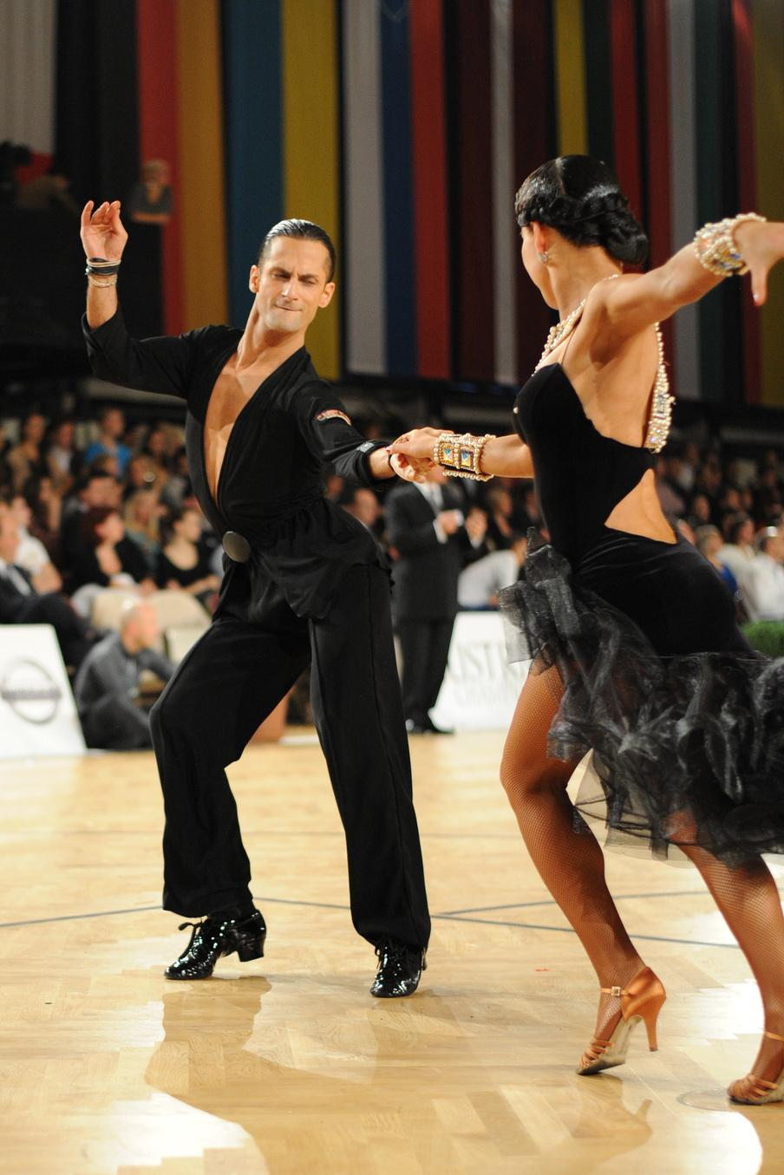
HEALTH BENEFITS OF JIVE
PHYSICAL BENEFITS:
IMPROVES CARDIOVASCULAR FITNESS
Jive dancing is a high-energy activity that gets your heart pumping and can help improve your cardiovascular fitness.
01
INCREASE MUSCLE STRENGTH AND FLEXIBILITY
02
The fast-paced and energetic movements of jive dancing can help to tone and strengthen your muscles, as well as increase your flexibility.

Slide 17
HEALTH BENEFITS OF JIVE
PHYSICAL BENEFITS:
ENHANCES COORDINATION AND BALANCE
Jive dance requires proper coordination of footwork and body movement. This repetitive practice improves your coordination and balance.
03
WEIGHT LOSS
04
Jive is a high-impact cardio dance, it burns calories and can help you lose weight.

Slide 18
HEALTH BENEFITS OF JIVE
MENTAL BENEFITS:
STRESS RELIEF
Dancing has been shown to release endorphins, which are chemicals in the brain that help to reduce stress and promote feelings of happiness and well-being.
01
ENHANCES MEMORY AND COGNITIVE FUNCTIONS
02
Jive dance requires mental focus, memory, and concentration, practicing Jive can help sharpen cognitive function.
03
BOOST CONFIDENCE AND SELF-ESTEEM
Jive dance is a fun and social activity that can help you feel more confident and positive about yourself.

Slide 19
HEALTH BENEFITS OF JIVE
SOCIAL BENEFITS:
IMPROVE SOCIAL SKILLS AND RELATIONSHIPS
Jive dance is often performed with a partner, which can help improve communication and social skills, as well as build stronger relationships.
01
CREATE A SENSE OF COMMUNITY
02
Dancing in a group class or social setting can create a sense of community and belonging among participants.

Slide 20
DIETARY GOALS OF JIVE
SUSTAINED ENERGY LEVELS
01
Jive is a high-energy dance style with fast-paced movements. Aim to consume a balanced mix of carbohydrates, proteins, and healthy fats to provide sustained energy for rehearsals and performances.
CARBOHYDRATE INTAKE
02
Carbohydrates are the primary source of energy for intense physical activities like jive. Include complex carbohydrates such as whole grains, fruits, and vegetables to fuel your workouts and maintain energy levels.

Slide 21
DIETARY GOALS OF JIVE
HYDRATION
03
Stay well-hydrated to prevent fatigue and ensure optimal muscle function. Drink water throughout the day, and increase intake before, during, and after practice sessions.
LEAN PROTEINS
04
Protein is crucial for muscle repair and recovery. Include lean protein sources like chicken, turkey, fish, beans, lentils, and tofu to support muscle health.

Slide 22
DIETARY GOALS OF JIVE
PRE-DANCE NUTRITION
05
Consume a balanced meal or snack that includes carbohydrates and protein about 1-2 hours before practicing or performing the jive dance. This can provide the necessary energy without causing discomfort during movement.
POST-DANCE RECOVERY
06
After a practice session or performance, have a snack or meal rich in carbohydrates and protein to aid muscle recovery and replenish glycogen stores.

Slide 23
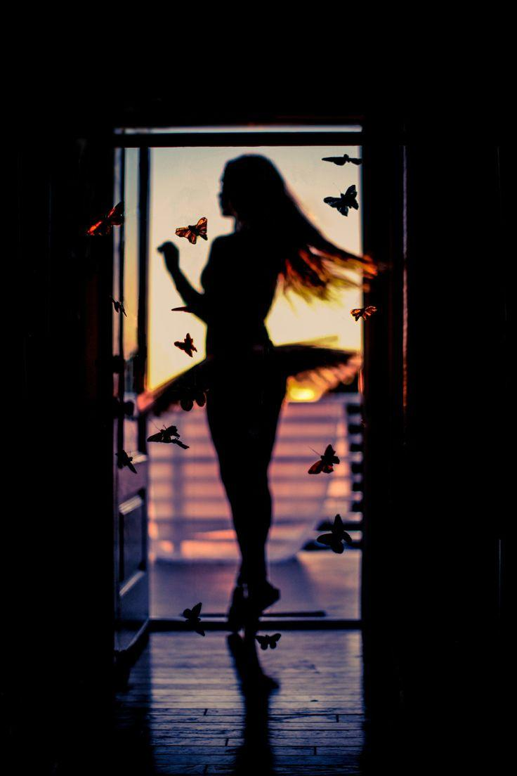
WEEK 12 | JIVE
THANK YOU FOR LISTENING!
MEMBERS:
RAMBOYONG, JHEDIAEL CALVIN T.
CAMIQUE, JAMES IVAN
JULIANE, CJ
ORIAS, FRANXINE
LLANES, KEVIN
PABUA, EMANN

